Slide 1
Preparing a Two Year Plan
Dr. Paul Murray
BUS 4970

Slide 2
Title Page
Don’t forget to write “Two Year Plan” in large font on the front
Company name
Professor’s name
World and Team numbers
List names of group members
Date

Slide 3
Format
Double-spaced, one-inch margins, 30-40 pages PLUS exhibits
Table of contents
  Include page numbers
  Include exhibits and/or appendix
Do NOT allow exhibits to cross pages
Number every page!

Slide 4
Contents
1. Introduction
2. Organization
3. Objectives & Industry Analysis
4. Strategies
5. Sales Forecast
6. Production Plan
7. Financial Statements
a. Proforma Assumptions
b. Financial Statements
c. Proforma Analysis
Appendix

Slide 5
Grading
Introduction, Organization, Overall Appearance, & Writing Quality of Report: 15%
Industry Analysis & Objectives: 15%
Strategies: 20%
Forecasts: 15%
Production: 10%
Financial Statements: 25%

Slide 6
1. Introduction
Overview of content of plan
Mission / Vision Statement
Brief discussion of company history, current position, & recent performance
  Feel free to be a little creative on company history
  Be sure to be accurate about recent performance
  Do NOT include product descriptions, which were required in the past for Two Year Plan assignments

Slide 7
2. Organization
Organization chart
Executive titles for each team member
Roles and responsibilities of each team member
Accurate background information on each team member
Photos (in business attire)

Slide 8
Organization Chart
Go Online to Check Out Actual Organization Charts & Choose a Set of Titles That Fit Your Company
CEO
VP Marketing
VP Operations
VP Finance
VP HR
Controller

Slide 9
3. Objectives (Goals)
Chart of Preliminary AND Final weighting factors
  Discuss rationale & any changes made
Quantified financial objectives for each of the 6 weighting factors
  How much & when to be achieved
  Amounts to be achieved, NOT % changes
  Briefly discuss feasibility of each target given your industry analysis

Slide 10
3. Industry Analysis
SWOT analysis?
Provide graphs showing the performance of each company in the industry over the past 8 quarters for $ sales, net income, ROA, ROE, and stock price
Discuss overall trends and the performance of your company relative to industry averages for each of the above indicators: Explain WHY?

Slide 11
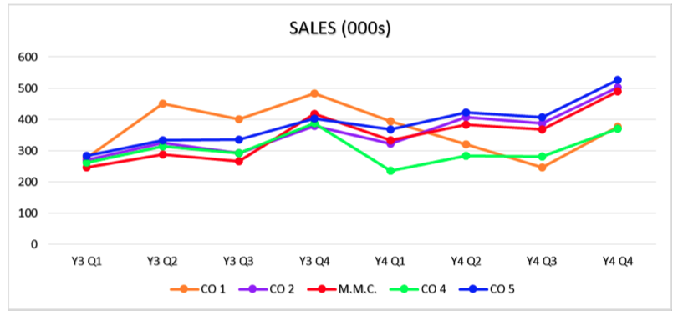
Use Line Graphs for Industry Analysis
Choose a Distinctive Color for Your Firm

Slide 12
4. Strategies
Very crucial section: must be clear, consistent and well-written
UNIQUE to your firm – what is your company’s competitive strategy?
Strategies for marketing, operations, & finance
  Include specifics for each variable you control in the game
  What you are planning to do & why

Slide 13
Tables for Strategy Section
  Tables & charts showing your planned decisions in each area for each quarter of years 5 and 6 are required.
  Think critically about what to display in table format and what to describe in writing.

Slide 14
5. Forecast
Discussion of techniques and assumptions used
Include entire SPREADSHEET with regression analysis, including data and regression variables (appendix)
Include TABLES of forecasts for INDUSTRY and COMPANY for 8 quarters in dollars and units
Show Company breakdown for each area

Slide 15
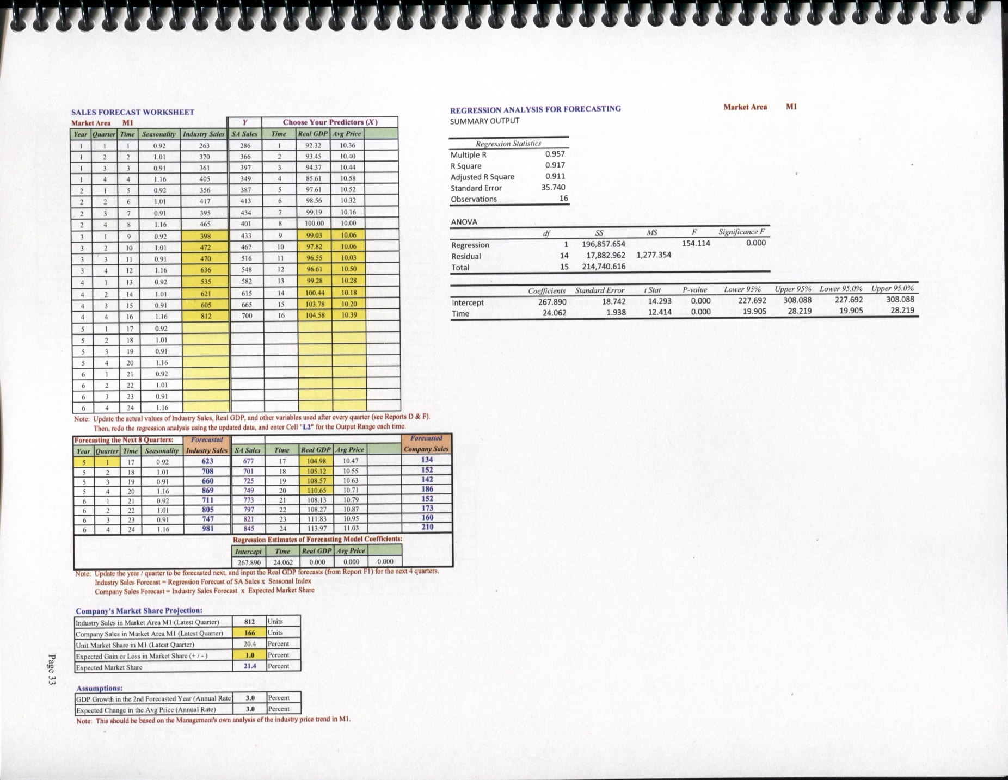
ENTIRE Forecasting Spreadsheet

Slide 16
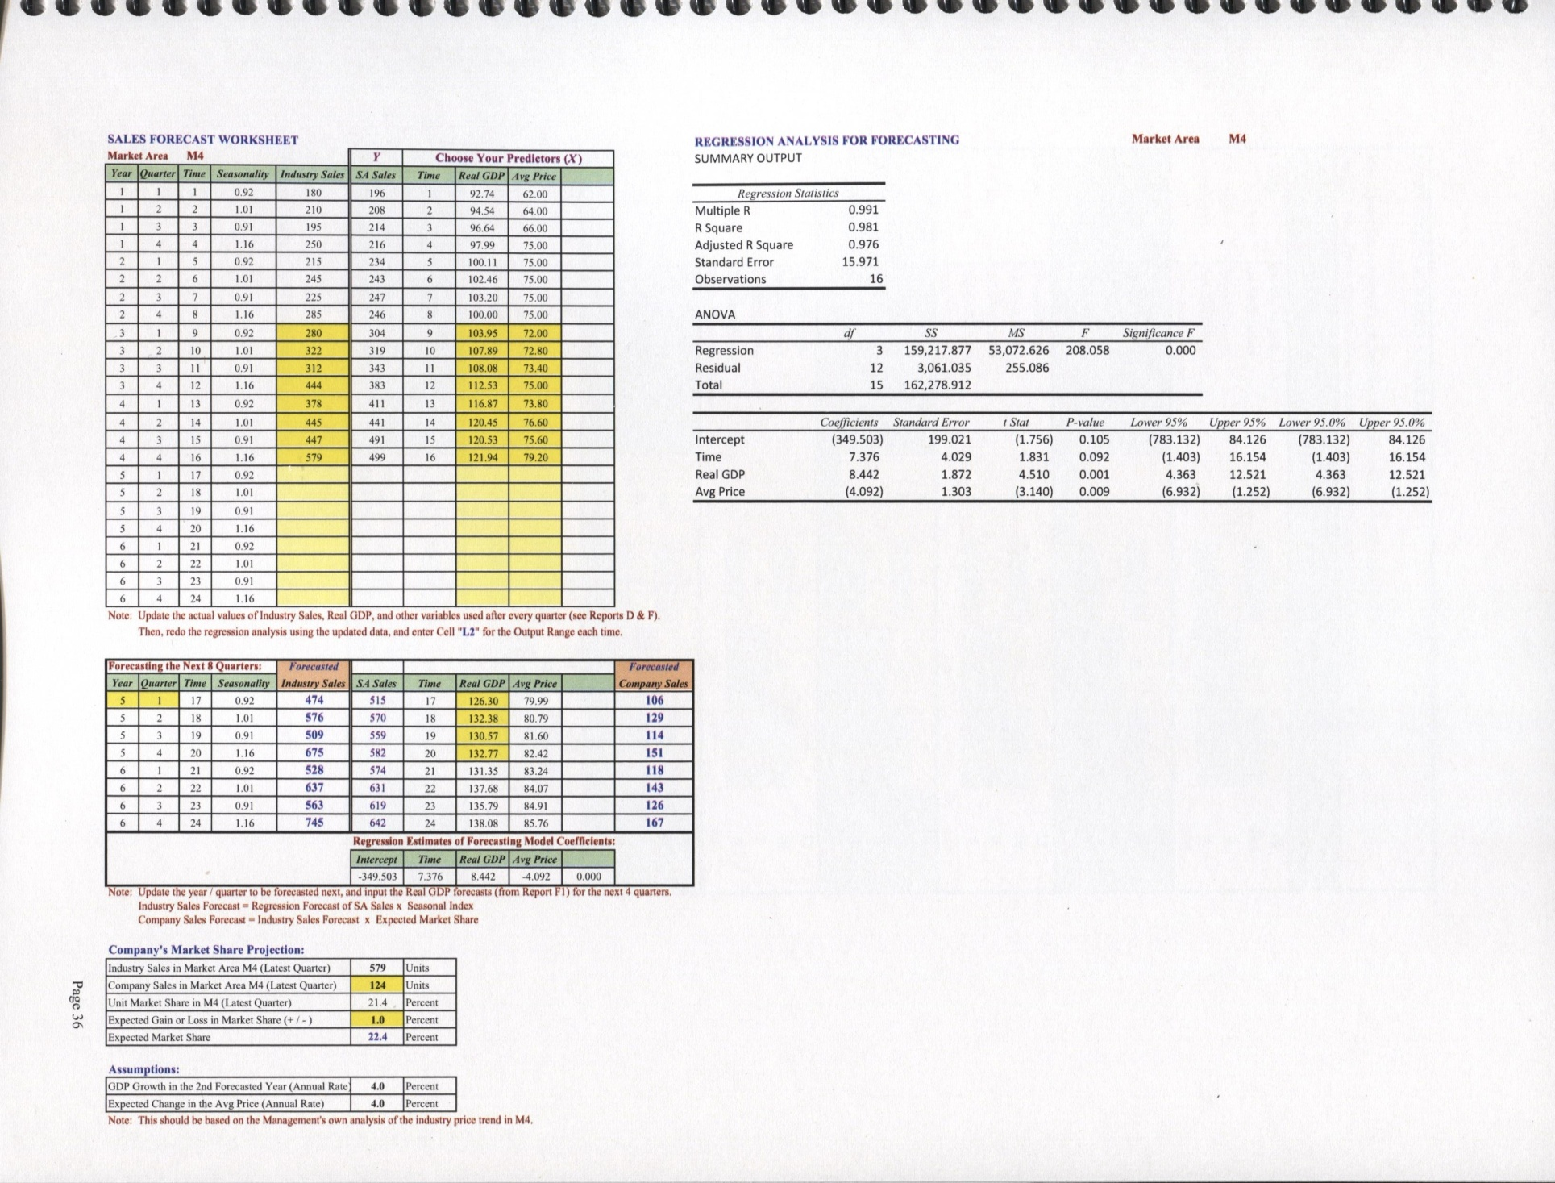
Forecasting Example: 3 Variables

Slide 17
6. Production Planning
Schedules for 8 quarters of planned production
  where produced & shipped
  expected beginning and ending inventory levels in each area.
  either BPG template or spreadsheet from forecasting lecture
Capacity plan
  Lines, shifts, OT for each quarter in each area with a plant

Slide 18
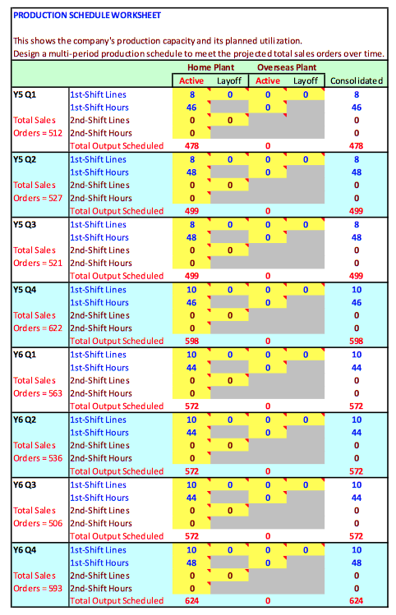
Capacity Plan

Slide 19
7. Financial Statements
See additional handout for format
  Income statements, annual & quarterly
  Balance sheets: annual
  Cash flow: annual & consolidated quarterly
Ensure CONSISTENCY with strategies
Include assumptions behind the statements (syllabus 7a)
Include pro forma analysis (syllabus 7c) to confirm goal achievement

Slide 20
Financial Statements
Page 1: Annual Consolidated Income Statements
Year 3 Year 4 Year 5 (forecast) Year 6 (forecast)
Page 2: Annual Consolidated Balance Sheets
Year 3 Year 4 Year 5 (forecast) Year 6 (forecast)
Page 3: Annual Consolidated Cash Flow
Year 3 Year 4 Year 5 (forecast) Year 6 (forecast)
Page 4: Year 5 Quarterly Consolidated Pro Forma Income Statements
Quarter 1 Quarter 2 Quarter 3 Quarter 4 Annual
Page 5: Year 5 Quarterly Consolidated Pro Forma Cash Flow
Quarter 1 Quarter 2 Quarter 3 Quarter 4 Annual
Page 6: Year 6 Quarterly Consolidated Pro Forma Income Statements
Quarter 1 Quarter 2 Quarter 3 Quarter 4 Annual
Page 7: Year 6 Quarterly Consolidated Pro Forma Cash Flow
Quarter 1 Quarter 2 Quarter 3 Quarter 4 Annual

Slide 21
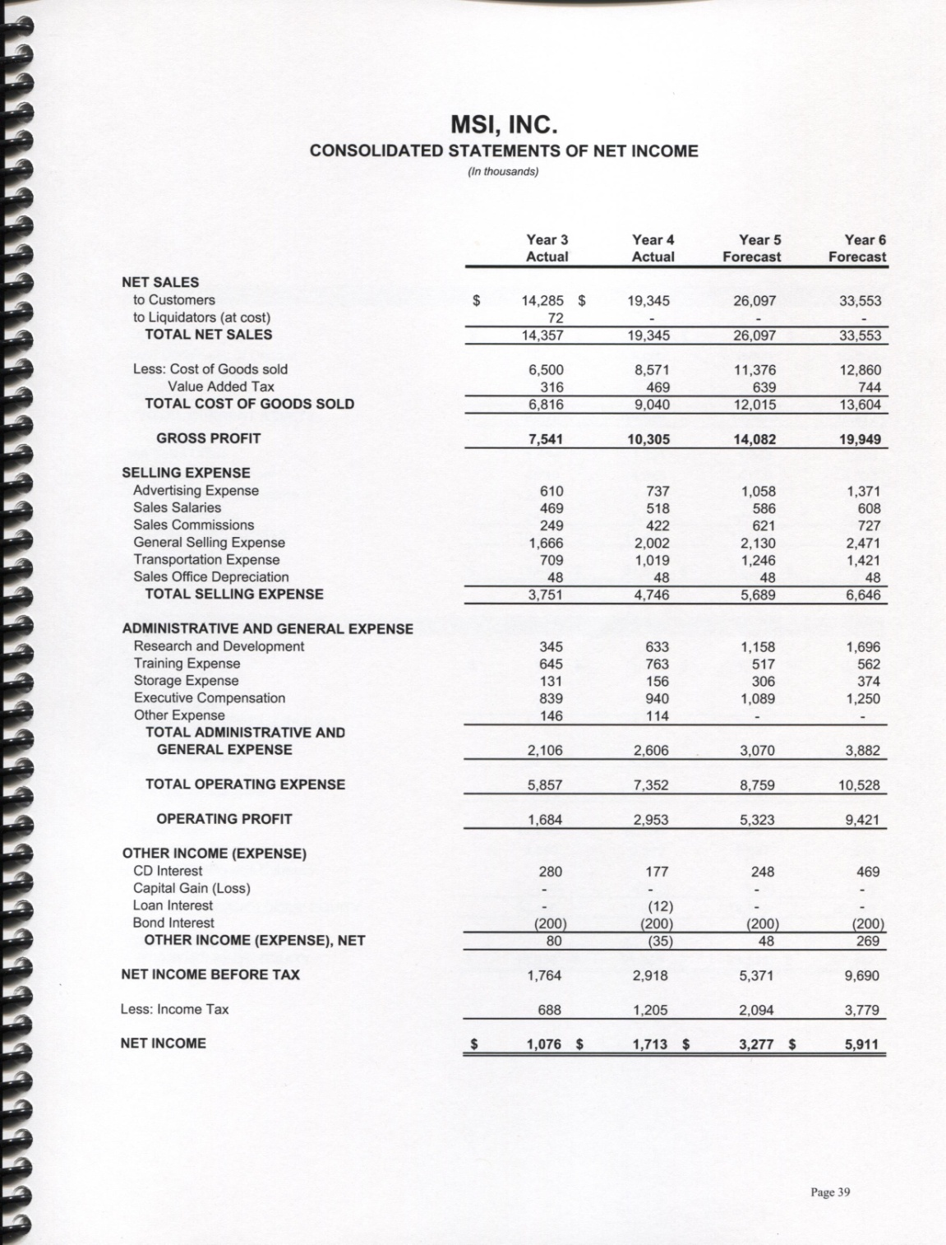
Income Statements Annual Consolidated

Slide 22
NO Decision Printouts
Some instructors require their students to include pages and pages of printouts of financial statements or operations statements from the game. I do NOT.
Including these extra pages just makes your plan harder for me to grade. I have copies of all of your decisions already. Including these extra pages is NOT a plus – wasted $ & effort.

Slide 23
Appendix
List of all team members and their contribution to each section of the report
Any extra tables or figures that do not go well in report.

